Slide 1
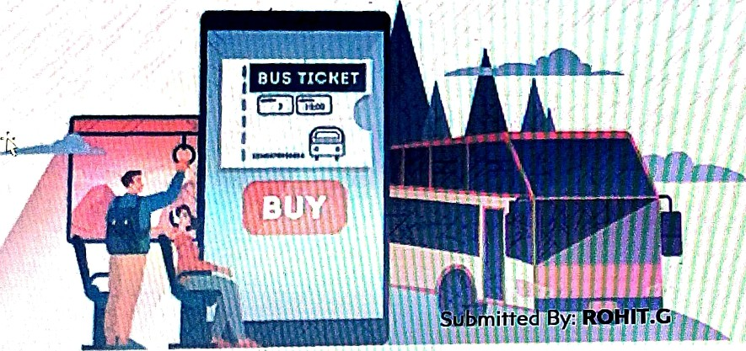
BUS RESERVATIOH SYSTEM
Reais†ra†ion No: S1OA212O53O5

Slide 2

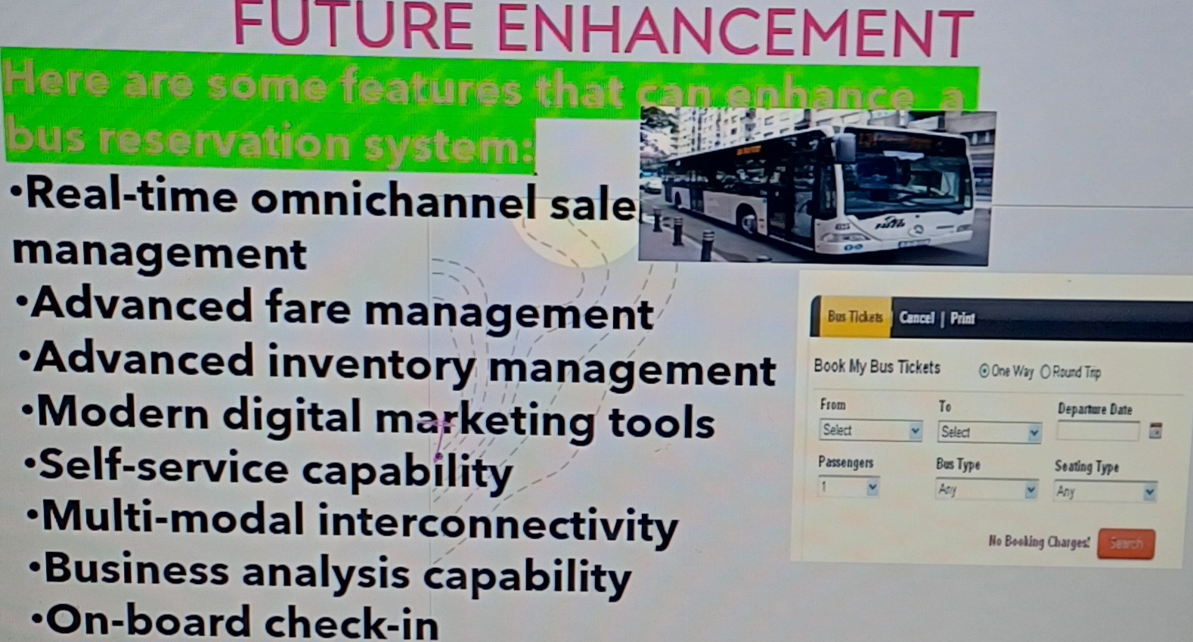

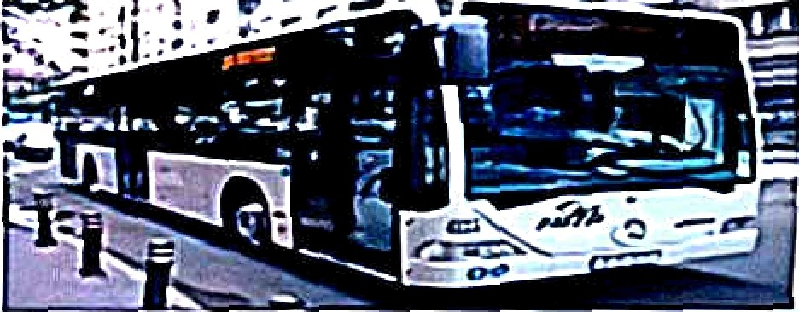



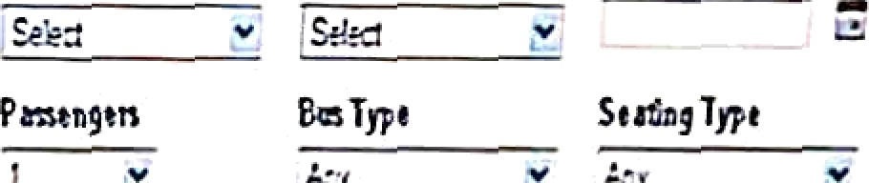

•Real-time omnichanne,IæpJe
management
•Advanced fare ma,iÎa§e¡;nent '
•Advanced inventorÿ'iÿianagement
•Modern digit I
k t” g tools
•Self-service c pabtÏiÎÿ/.--'
•Multi-modal interconnectivity
•8usiness analysis capability
•On-board check-in

Slide 3
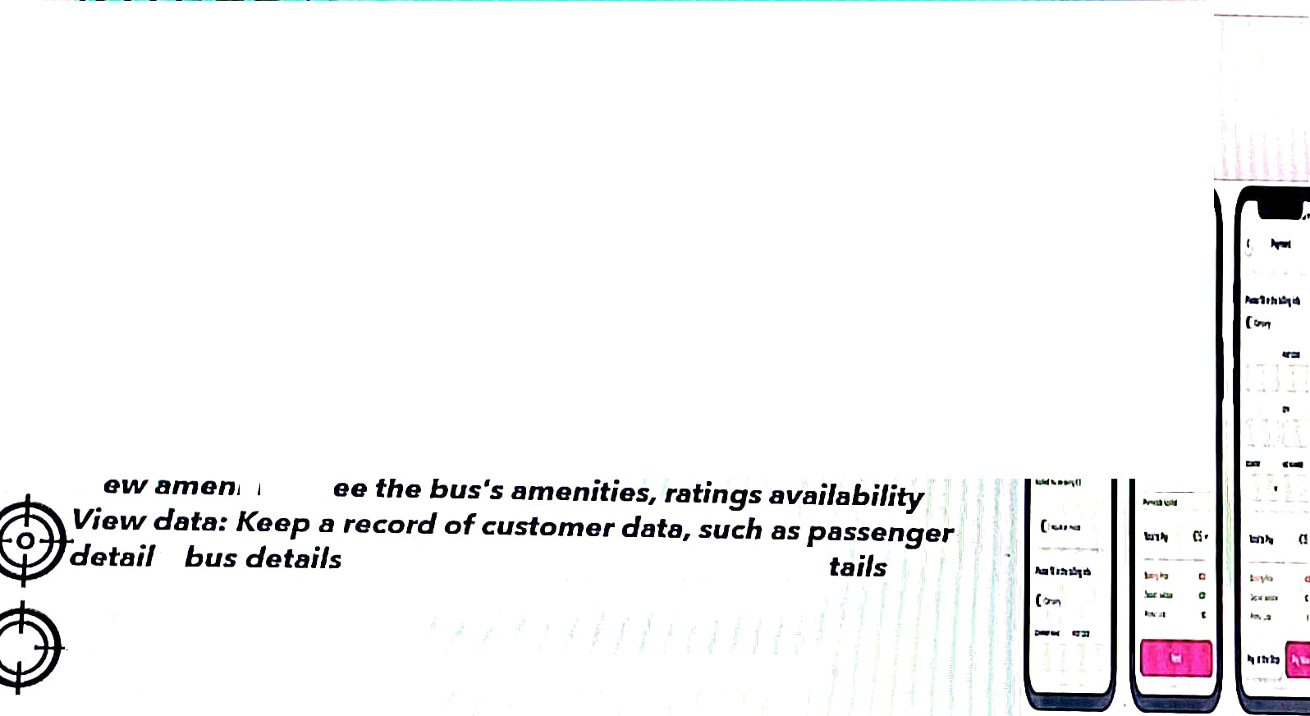
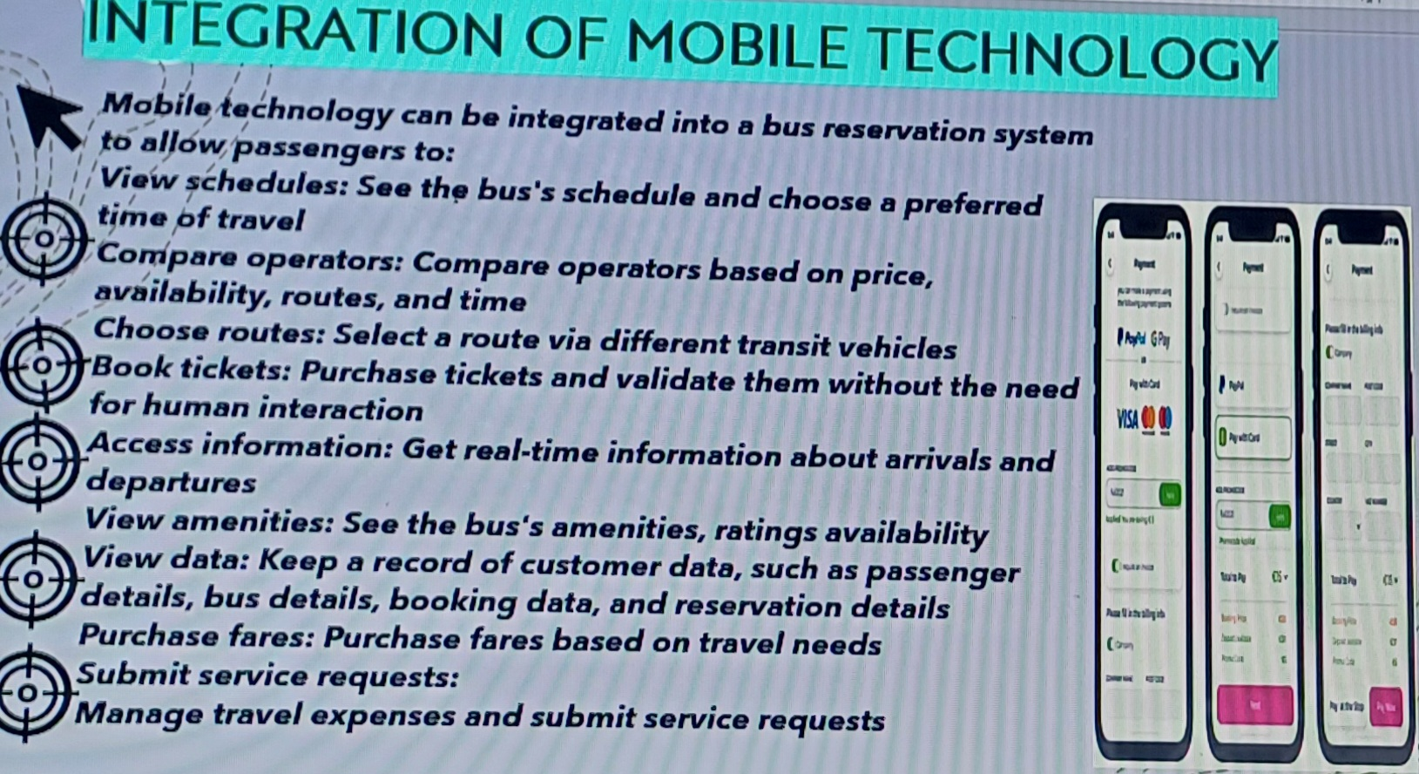



















^{kGRATI}ON OF MOBILETECHNOLOGY
¡1 Nl
I -
' '’$p•'1g' “»••Ìê•°g”g•t“ê’° •-=mreœd’“ ° y= ¢gp$
oparatom:
^*^^^"l•öiIñy, routas,
^{Oż¥ş@}azæ o_{R}ørators 6aseó on [sricø,
_{hook} routas.• Saíam a routa Kiø cÏiHarant trønsú _{vahizías}
^{ticka}'*•' *'*r‘*°*• *'‘*’•’• •n•! *•›id•ta tham without tha »«p
SubzrzW service requests:
Mand
€t travøl ax_{R}aN6zts and subzzzit søi-vice raquesM

Slide 4
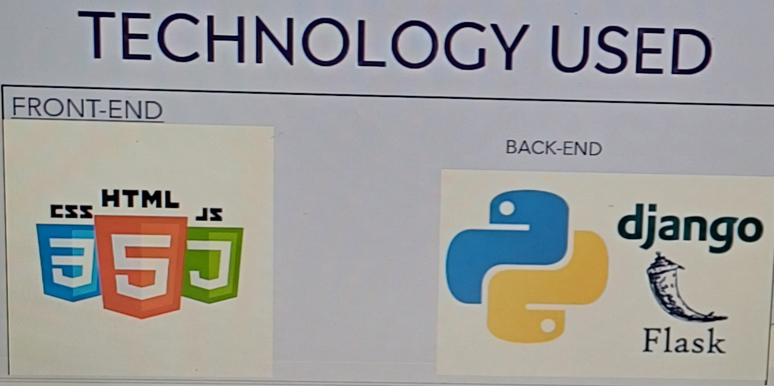





TECH
LOGY USEO
FRONT-END
BACK-ENO
MTtñL
djan@o
Flask

Slide 5
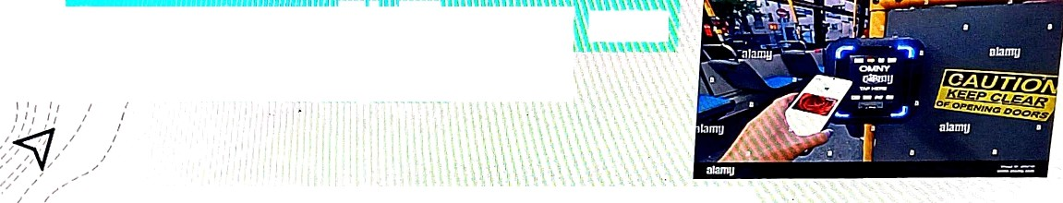









Ticltetang: Using their NFC-enabled devices, passengei s can buy and check their
Contactless Payments: NFC allon s passengers to pay for tickets, snacks, and oilier onboard services using their devices. Far e Collection: NFC can collect fares front passengerii and improve fare collection pi ocedures' efficiency.
hook for the contactless symbol on your creclit or debit car d to see if your card is contactless enabled.
yl p;j, poai-cl a bus With the contactless symbol and instead of pa) irig u‹it1i CaSh,
simply tap yotn cai d or contactless-enabled device onto the reader and

Slide 6

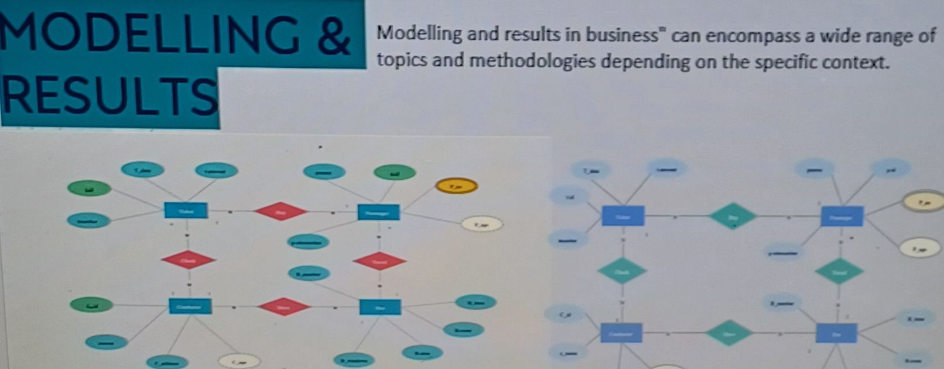






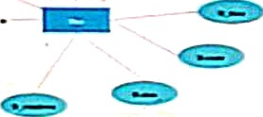

lviodeI!ing and results in business° can encompass a wide mnge of
topics and methodologies depending on the specific context.
.-
*”

Slide 7


aclusion, a well-designed bus reservation system offers numerous benefits to both passengers
.vides convenience and flexibility by allowing them to book tickets online or through mobile a;
!rences, and avoid long
es at ticket counters. Additionally, it offers real-time information about bus schedules, routes, a
all travel experience. “
he other hand, for bus operators, a reservation system stream lines the ticketing process, efficie
nations, and. By combining these elements into a visually appealing infographic or presentation slide, you ‹
:tively summarizes the performance and impact of the bus res mation system.
T’
“!

Slide 8
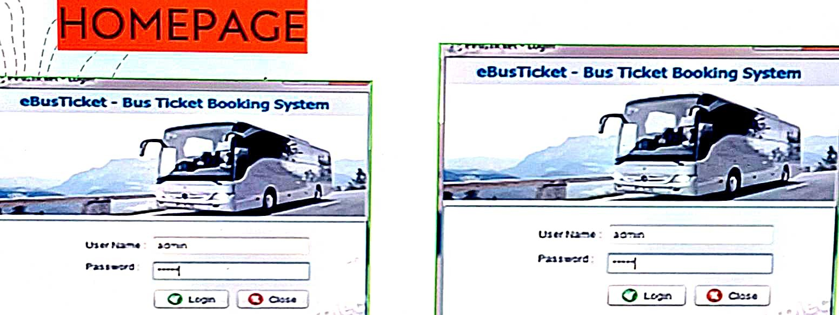

Slide 9

THANI1 YOU

